Slide 1
Analysing The Cricket World Cup 2023
An overall analysis of the tournament
The Cricket World Cup, officially known as ICC Men's Cricket World Cup, is the international championship of One Day International cricket.

Slide 2

Aim of analysing the world cup 2023 data!
The Cricket World Cup 2023 can provide valuable insights into player performance, form, and potential emerging talent.
Using the World Cup data selectors can formulate their strategies for player auctions. Consider the balance of their squad, the roles each player will fulfill, and the team's overall strategy.
The performance in international tournaments may not always directly translate to success in domestic T20 leagues, but it can provide valuable insights into a player's current form and abilities.
Additionally, staying updated with the latest news and player developments is essential for making informed decisions as a team owner.
NOTE: Final match data is not included in the analysis and the data used here is taken from ‘Kaggle’.

Slide 3
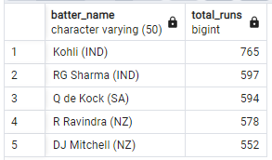
Top 5 best performing batters through out the world cup
SELECT player AS Batter_name,
SUM(runs) AS Total_runs
FROM world_cup
WHERE bat_or_bowl = 'bat'
GROUP BY 1
ORDER BY 2 DESC
LIMIT 5

Slide 4
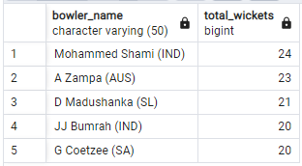
Top 5 wicket taking bowlers throughout the tournament
SELECT player AS Bowler_name,
SUM(wkt) Total_wickets
FROM world_cup
WHERE bat_or_bowl = 'bowl'
GROUP BY player
ORDER BY 2 DESC
LIMIT 5

Slide 5
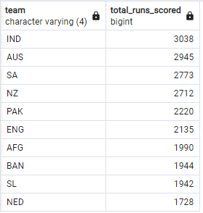
Total runs scored by each the teams
SELECT team,
SUM(runs) AS Total_Runs_Scored
FROM world_cup
WHERE bat_or_bowl = 'bat'
GROUP BY 1
ORDER BY 2 DESC

Slide 6
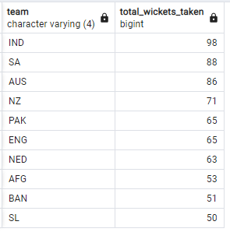
Total wickets taken by the teams
SELECT team, SUM(wkt)AS Total_wickets_Taken
FROM world_cup
WHERE bat_or_bowl = 'bowl'
GROUP BY 1
ORDER BY 2 DESC

Slide 7
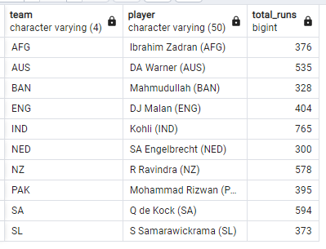
Highest run scored by a player in each team
WITH cte AS(
SELECT team, player,SUM(runs) AS total_runs,
RANK() OVER(PARTITION BY team ORDER BY SUM(runs) DESC) AS rnk
FROM world_cup
WHERE bat_or_bowl = 'bat'
GROUP BY 1,2
)
SELECT team,player,total_runs
FROM cte
WHERE rnk = 1

Slide 8
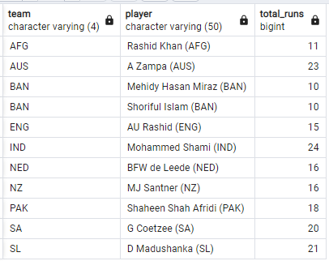
Highest wicket taking players in every teams
SELECT team, player, total_wicket
FROM(
SELECT team, player,SUM(wkt) AS total_wicket,
RANK() OVER(PARTITION BY team ORDER BY SUM(wkt) DESC) AS rnk
FROM world_cup
WHERE bat_or_bowl = 'bowl'
GROUP BY 1,2
) AS abcd
WHERE rnk = 1

Slide 9
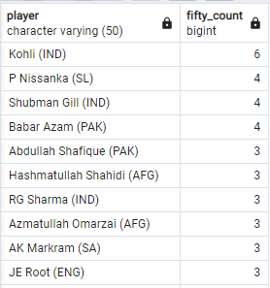
Batters who have reached a half century
SELECT player, COUNT(runs) AS fifty_count
FROM world_cup
WHERE bat_or_bowl = 'bat'
AND runs BETWEEN 50 AND 99
GROUP BY 1
ORDER BY 2 DESC
AND MANY MORE...

Slide 10
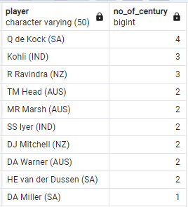
Batters who have scored a century of runs
SELECT player, COUNT(runs) no_of_century
FROM world_cup
WHERE bat_or_bowl = 'bat'
AND runs BETWEEN 100 AND 199
GROUP BY 1
ORDER BY 2 DESC
AND MANY MORE...

Slide 11
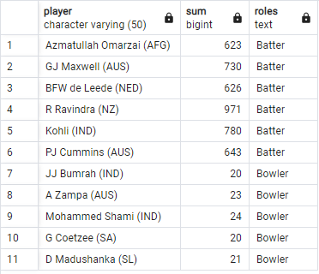
Create the best team in world cup !
(SELECT player, SUM(runs), 'Batter' AS Roles
FROM world_cup
GROUP BY 1
ORDER BY 2 DESC
LIMIT 6)
UNION
(SELECT player,SUM(wkt), 'Bowler' AS Roles
FROM world_cup
WHERE bat_or_bowl = 'bowl'
GROUP BY player
ORDER BY 2 DESC
LIMIT 5)
ORDER BY Roles
Note: Players have been selected on the basis of their batting score and wicket taken

